Slide 1

ENSA General Assembly
Venice, 15 November 2022
EN-SEL Network
Bo Stal
Denise Jansen
Floreanne Burema
Thijs Zwarts

Slide 2
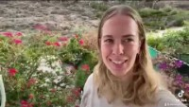

Slide 3
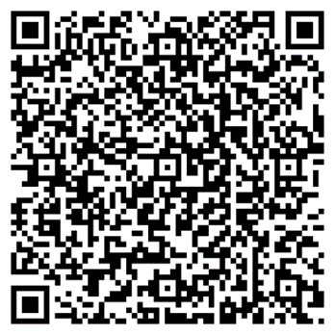

Design Thinking
Empathize
Define
Ideate
Prototype
Test
1.
2.
3.
4.
5.
For more information about the minor Beyond Borders!

Slide 4
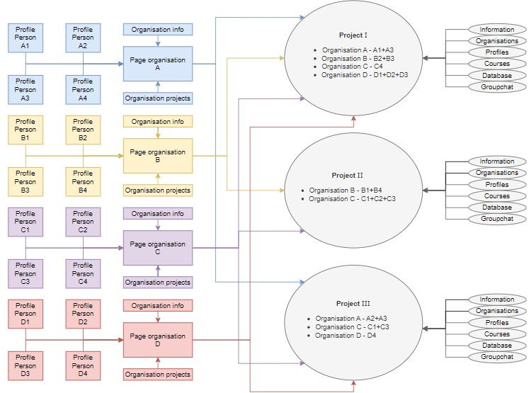
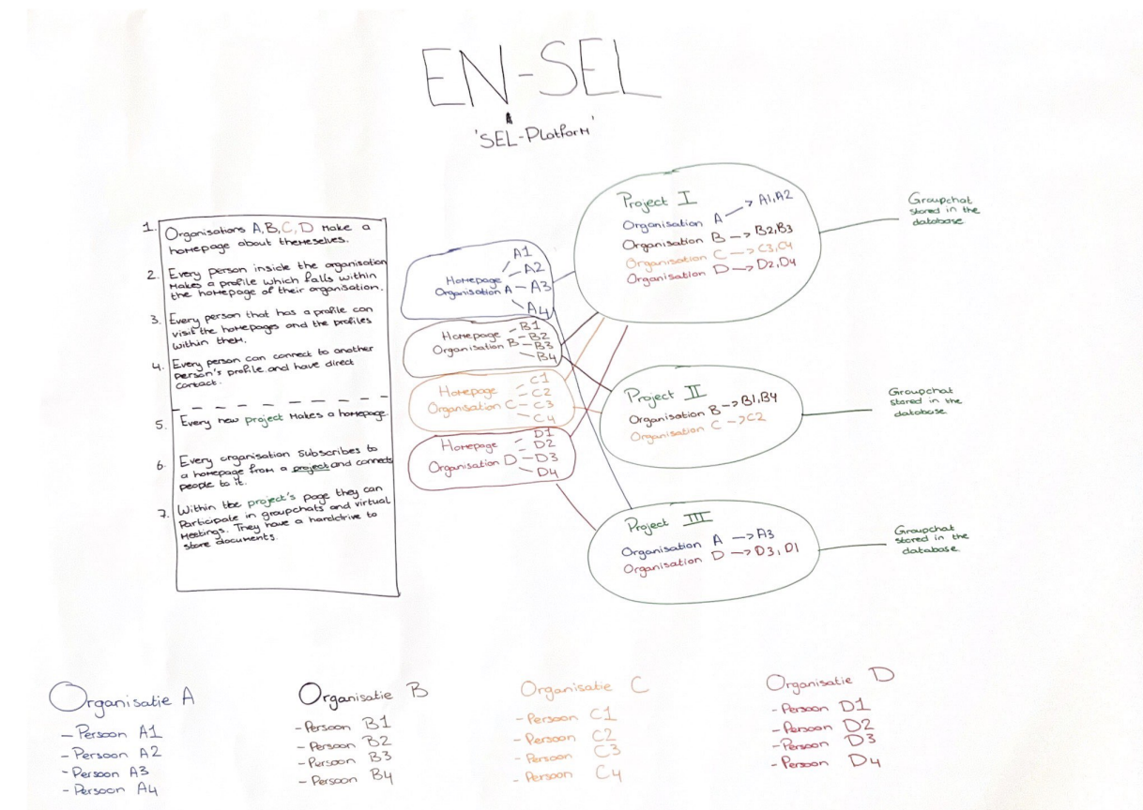
Prototype

Slide 5


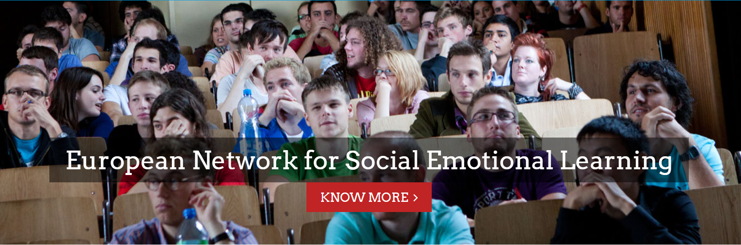
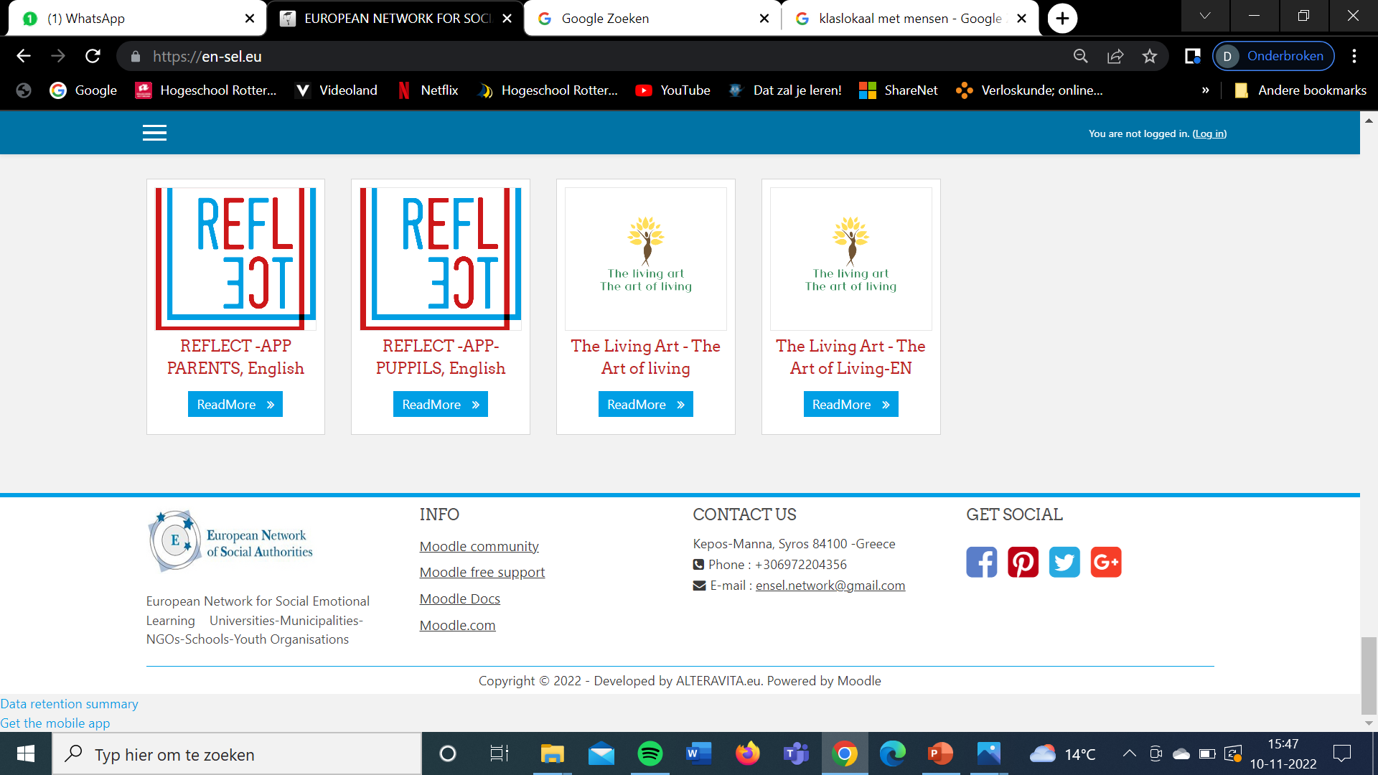
Log in
Home History Vision & mission Organisations Projects

Slide 6

A
B
C
H
Log out
Home History Vision en mission Partners Projects Courses
A B C D E F G H I K L M N O P Q R S T U V W X Y Z
Altera Vita Social Cooperative of Cyclades
Ajuntament De Castello
Ajuntament De Terrassa
Bubama
Centre Commundt d’action social de Marseille
Conseil Departmental du val de Marne
Comumidad de Madrid
Rotterdam University of Applied Science

Slide 7

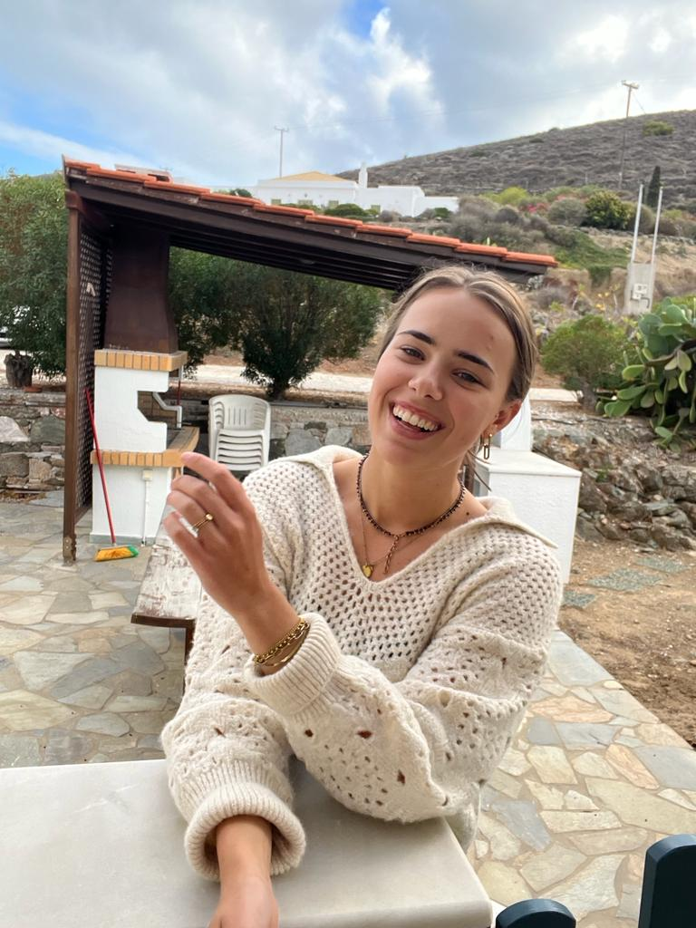
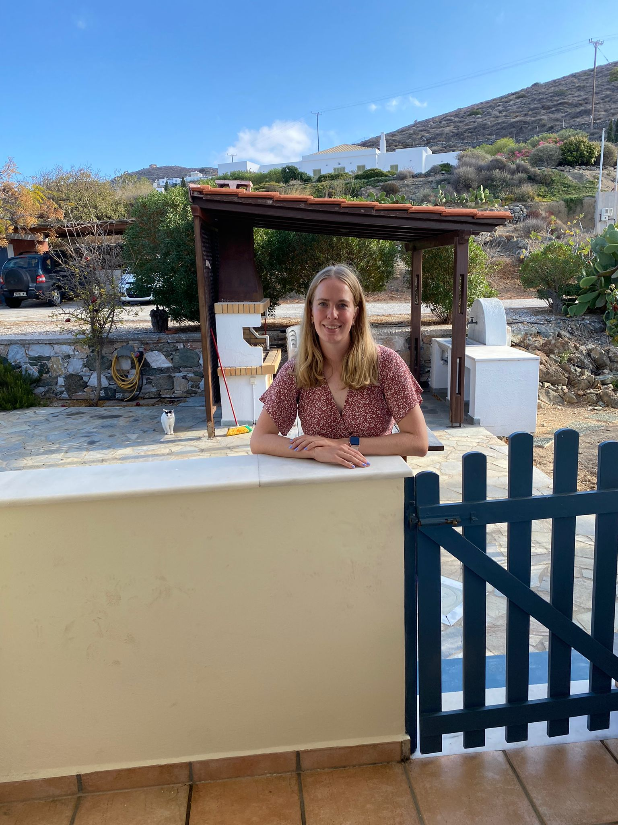
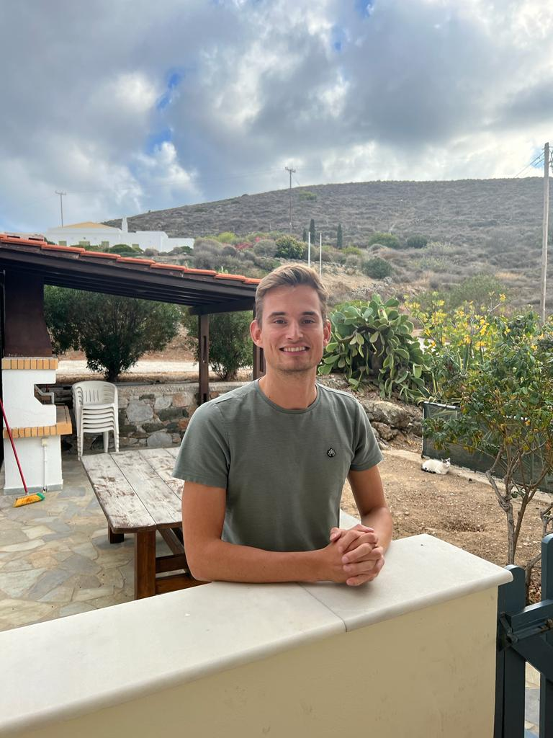
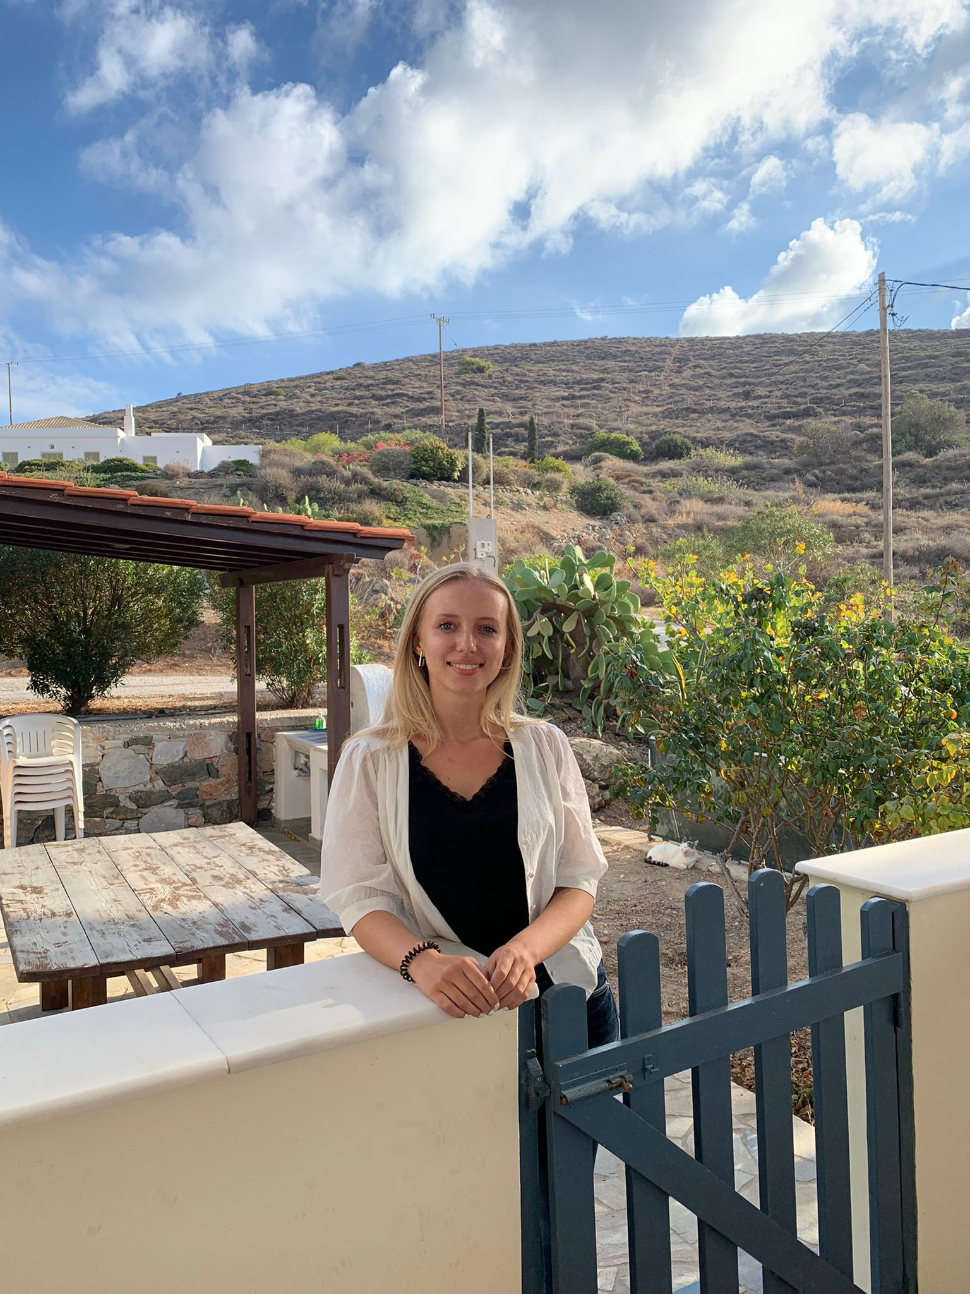
Log out
Home History Vision en mission Partners Projects Courses
Rotterdam University of Applied Science
Information
Rotterdam University of applied sciences counts for approximately 40,000 students and 4,000 employees.
The courses have a wide range in almost every education sector.
One of the available minors is the Beyond Borders minor, students from other disciplines and (international) clients work together on issues aimed at reducing health inequalities at home and abroad. The international context distinguishes this minor from other minors.
More: Μinor Beyond Borders
Connect
Denise Jansen
Floreanne Burema
Thijs Zwarts
Bo Stal

Slide 8
Log out
Home History Vision en mission Partners Projects Courses
Denise Jansen
Information
21 years old
Third year midwife student
Minor Beyond Borders
Projects
EN-SEL Network
Connect
Three persons more
Denise Jansen
University of Rotterdam
Floreanne Burema
University of Rotterdam
Thijs Zwarts
University of Rotterdam
Bo Stal
University of Rotterdam

Slide 9
Log out
Home History Vision en mission Partners Projects Course
EN-SEL Network
Connect
Information
ENSEL (European Network for Social Emotional learning) aims to implement life skills in a holistic way, helping young people exercise their fundamental rights in the home, school, class and community.
Available courses
Not available.
Denise Jansen
University of Rotterdam
Floreanne Burema
University of Rotterdam
Thijs Zwarts
University of Rotterdam
Bo Stal
University of Rotterdam
Miltos Sakellariou
Altera Vita

Slide 10
Log out
Home History Vision en mission Partners Projects Courses
Courses
See more..

Slide 11
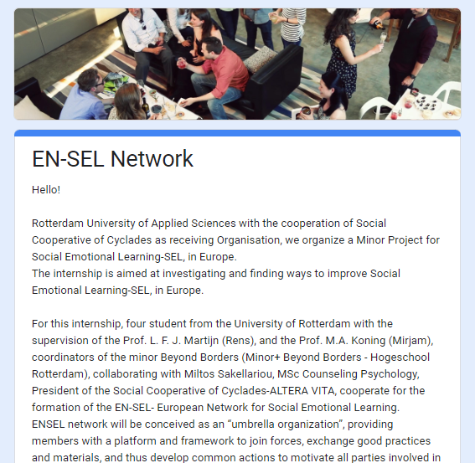
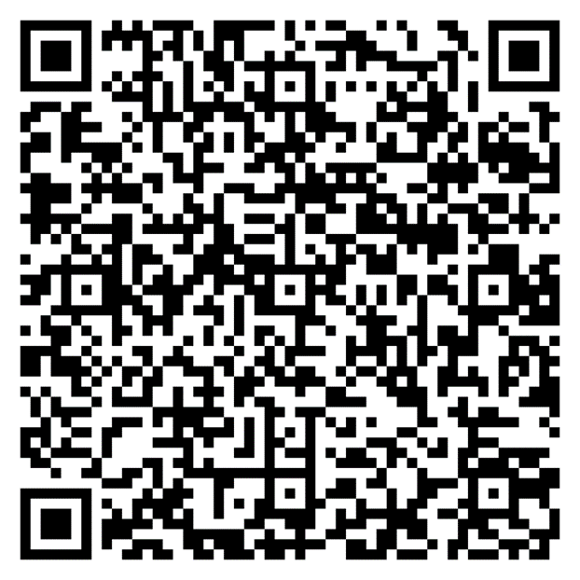
Fill in our questionnaire!

Slide 12

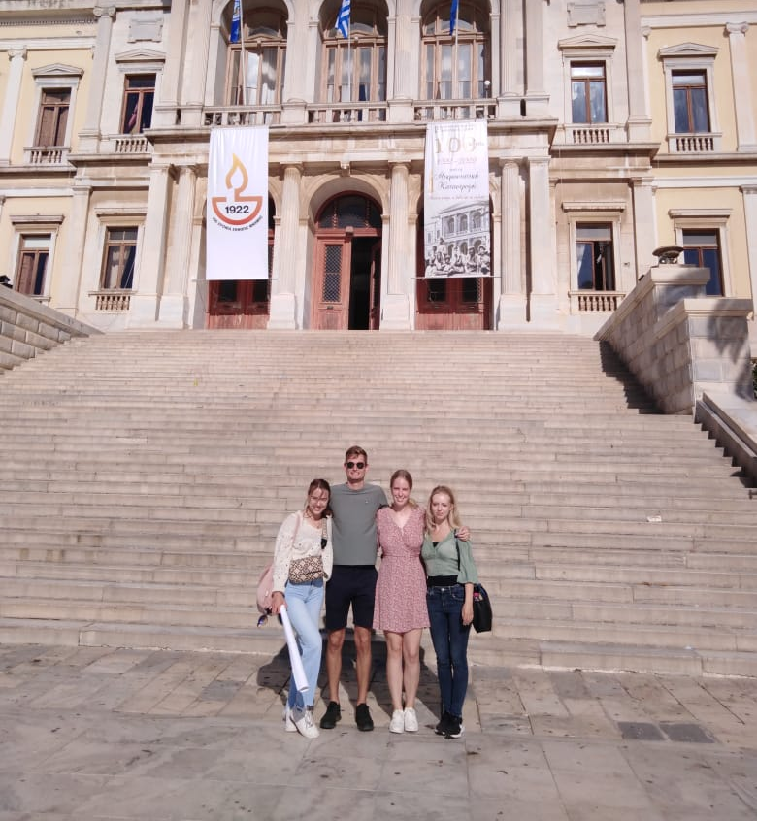
Thank you for your attention!
Miaouli Square, Ermoupoli, Syros

