Slide 1



ERASMUS+
Live on the island
1st Training Course
18-27/04/2023 CROATIA
Social Cooperative of Cyclades
ALTERA VITA
Miltos Sakellariou
Chairman of the Board
MSc Counseling Psychology

Slide 2
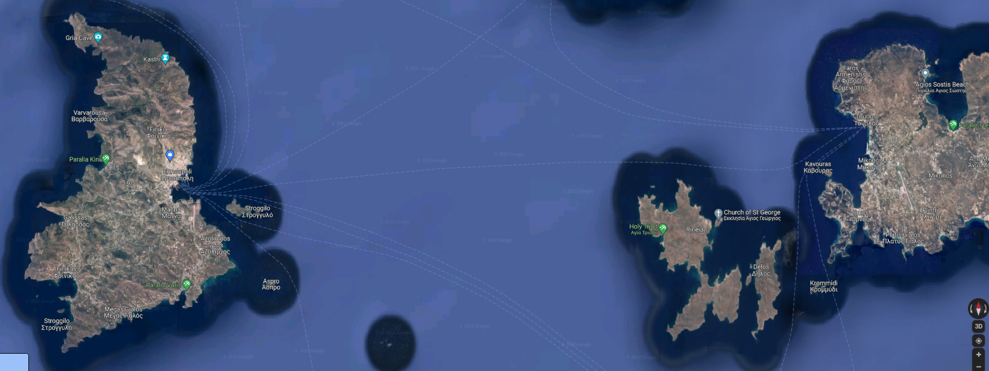
SYROS ISLAND-CYCLADES
SYROS ISLAND

Slide 3
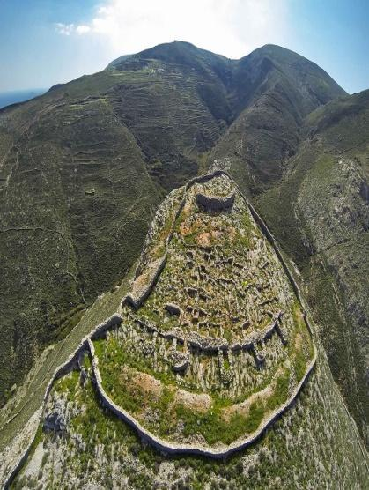
KASTRI 2700 B.C.

Slide 4
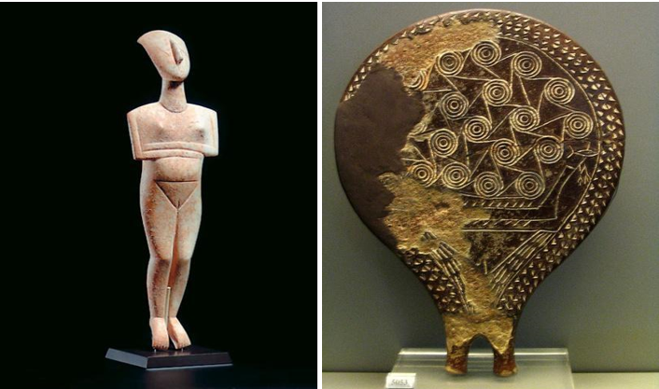
SYROS ISLAND-CYCLADES

Slide 5
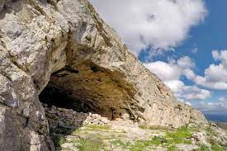
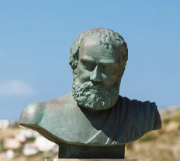
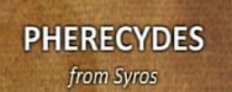

PHILOSOPHER FERECYDES

Slide 6

Local Network
Adm/
Support
MEMBERS -VOLUENTEERS
Social Cooperative of Cyclades ALTERA VITA
ARCHIPELAGOS
SOUTH AEGEAN
Municipality of Syros-
General Hospital of Syros
Society for the Protection of Minors of Syros
Erasmus+

Slide 7
Altera Vita
Administrative Board: Miltos Sakellariou, Chairman of the Board
Prevention Counselor in Addictions, Family Therapist
Giannis Daskos, Prof of Maths, General Secretary
Eleni Karagianni, Educator, Youth worker, Treasurer
Altera Vita Team Antonia Sakellariou, ICT Expert, Project Manager
Pavlos Aimoniotis, ICT Expert, Technical Manager
Miranda Daskou, Biologist, Youth worker
Leonardos Palaiologos, Youth worker
Aggeliki Sakellariou, Facilitator, Occupational Therapist
Eleftheria Pouftsi, Volunteer, Occupational Therapist
Agni Kapella, Logistics, Secretary
Dimitra Sakellariou, ICT Expert, Technical Manager
Alekos Chalavazis, ICT Expert, Technical Manager
Apostolos Efkarpidis, RN Νurse, MSc, PhDc, Health Promotion Programs
With the ERASMUS + programmes are involved also other members of ALTERA VITA, Social Workers, Psychologists, teachers, ICT specialists, youth workers.
We have the Quality Label from European Solidarity Corps as Hosting and Sending Organization. We involve in our activities also volunteers.

Slide 8
ALTERA VITA
Our aims are:
education, human rights, employment, social discrimination, racism, culture
Cultural and social development of our community
Promotion of volunteer spirit
Social Economy, Health Promotion, Organic Farming, Environment and Sustainable Development, the Arts and Culture, Pedagogy, Psychology, New technologies.
Participation in European projects

Slide 9
Our Objectives
To develop collaborative practices in and around schools and the community:
- School organization and leadership
- Support for teachers
- Support for students
- Involvement of parents and extended families
- Involvement of other Professionals stakeholders

Slide 10

BODIES AND SERVICES INVOLVED
Municipality of Syros
Hospital of Syros-KEFIAP
Union of Social Cooperatives of South Aegean -Archipelagos
Society for the Protection of Minors- Public Entity
Association of Blind people of Cyclades -AROGI.
Network of Prevention & health promotion of Cyclades.
Society of Protection of Minors-Court of Appeal South Aegean
Erasmus+

Slide 11

Archipelagos Union of Social Cooperatives of South Aegean
Our vision is the social and solidarity economy and cooperation is a valuable framework for us.
20 Social Cooperatives from South Aegean participate at Arhipelagos

Slide 12
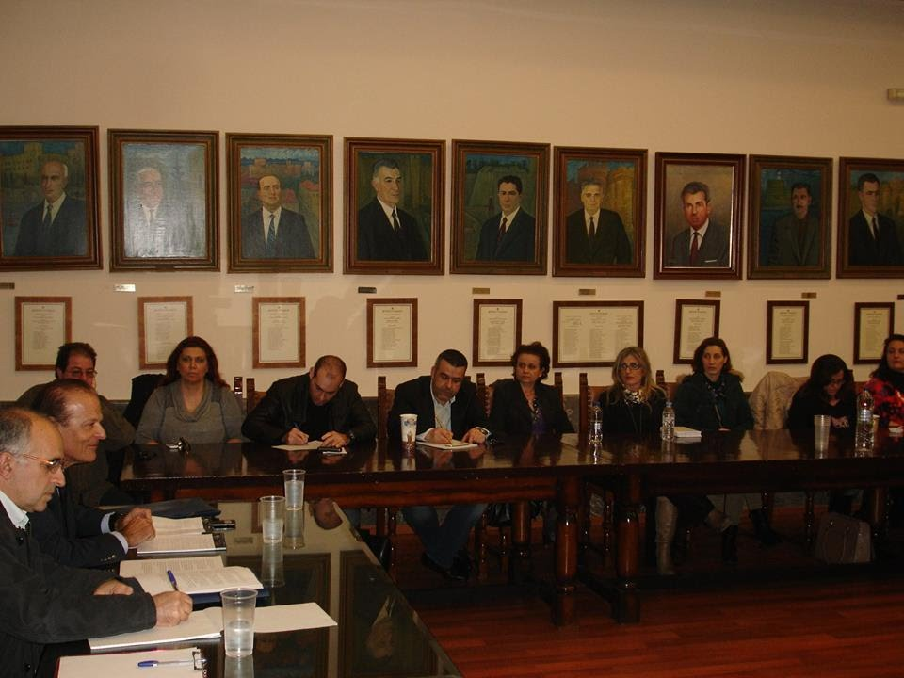
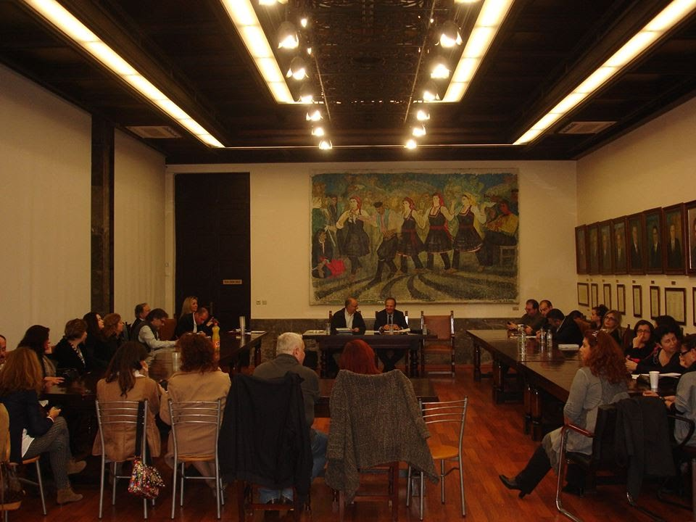
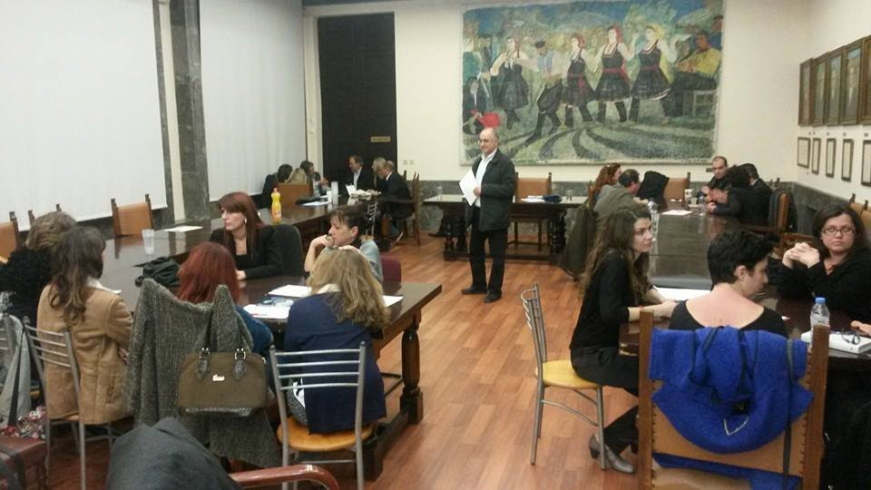
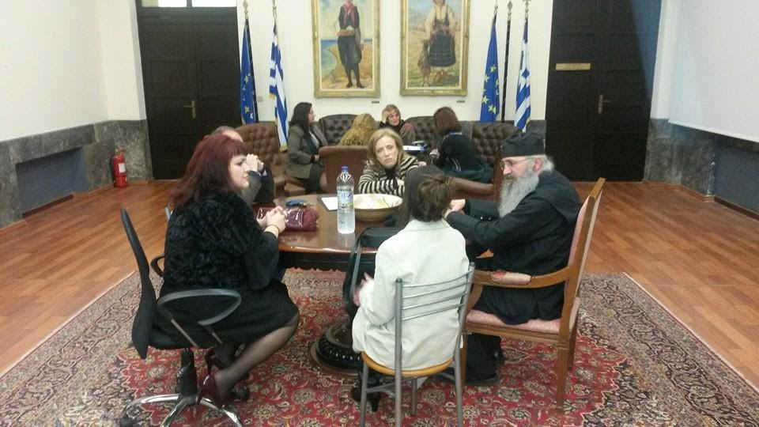
PREVENTION & HEALTH PROMOTION NETWORK OF THE CYCLADES

Slide 13
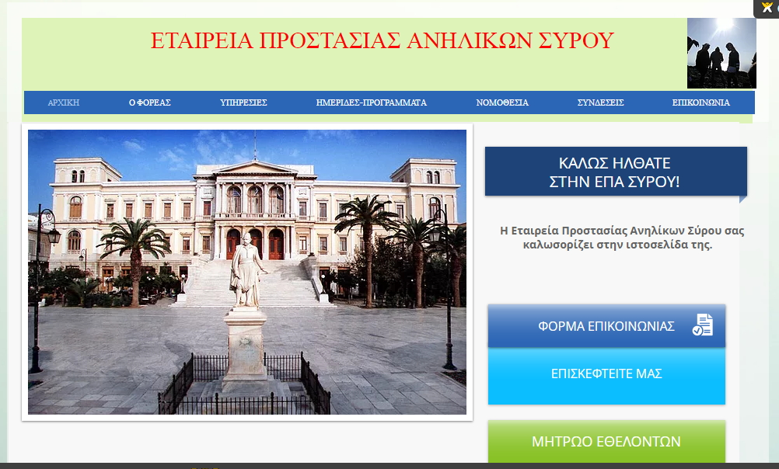
SOCIETY FOR PROTECTION OF MINORS
Court of Appeal South Aegean
Erasmus+

Slide 14
Multidisciplinary Team
Τhe Multidisciplinary Team is dealing mostly with Prosecution Prosecutor's Office, but it can also support families who come for help.
The EPA Syros has jurisdiction over all the islands of the Cyclades that belong to the Aegean Court of Appeal and its purpose is to prevent victimization and to deal with juvenile delinquency, to raise awareness among parents and the wider community
Finally, can provide legal assistance to minors in the cases provided for by the law.

Slide 15
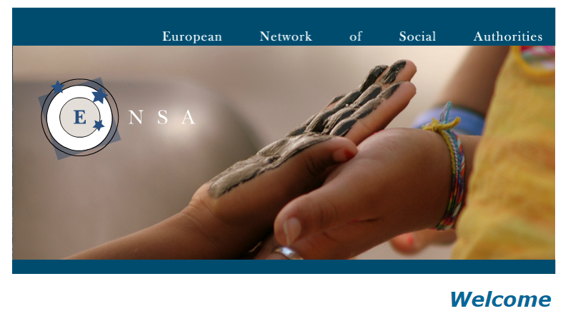
ENSA NETWORK
Erasmus+

Slide 16
European Network of Social Authorities-ENSA NETWORK
European Network of Social Authorities is a network of cities and European Regions that has the aim of promoting international cooperation in the social field.
ENSA was established by the Veneto Region in 1999. Since then the network has developed and supported solid partnerships between a wide range of European Regions and has carried out seminars, conferences, study visit programmes and exchanges of professionals.

Slide 17
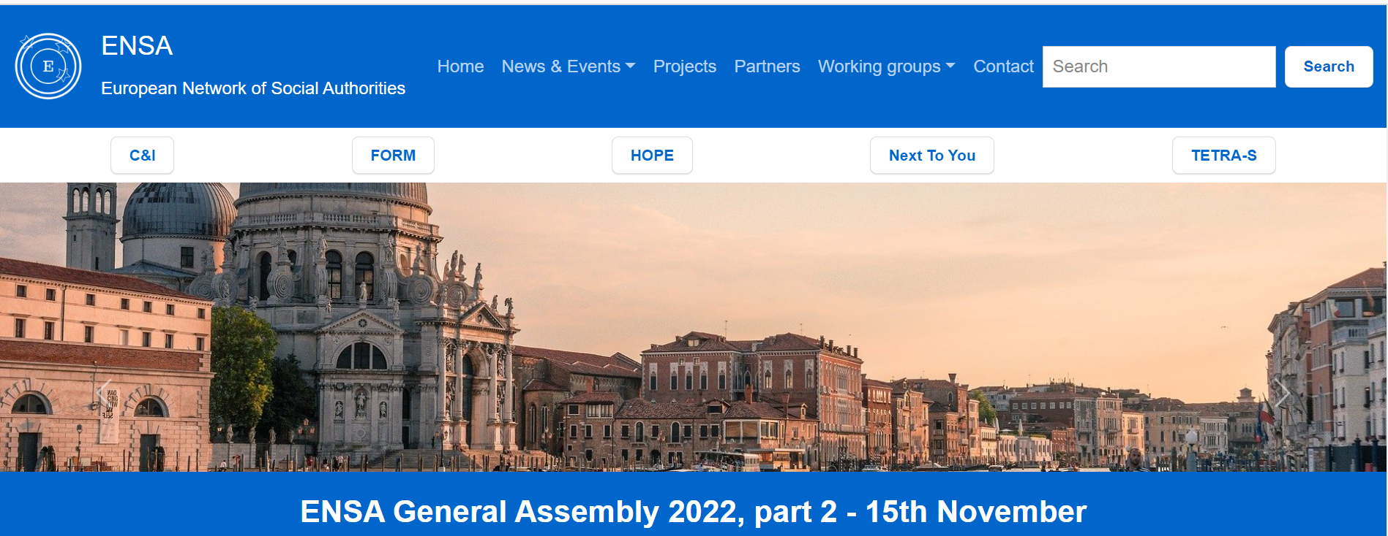
https://www.ensa-network.eu

Slide 18
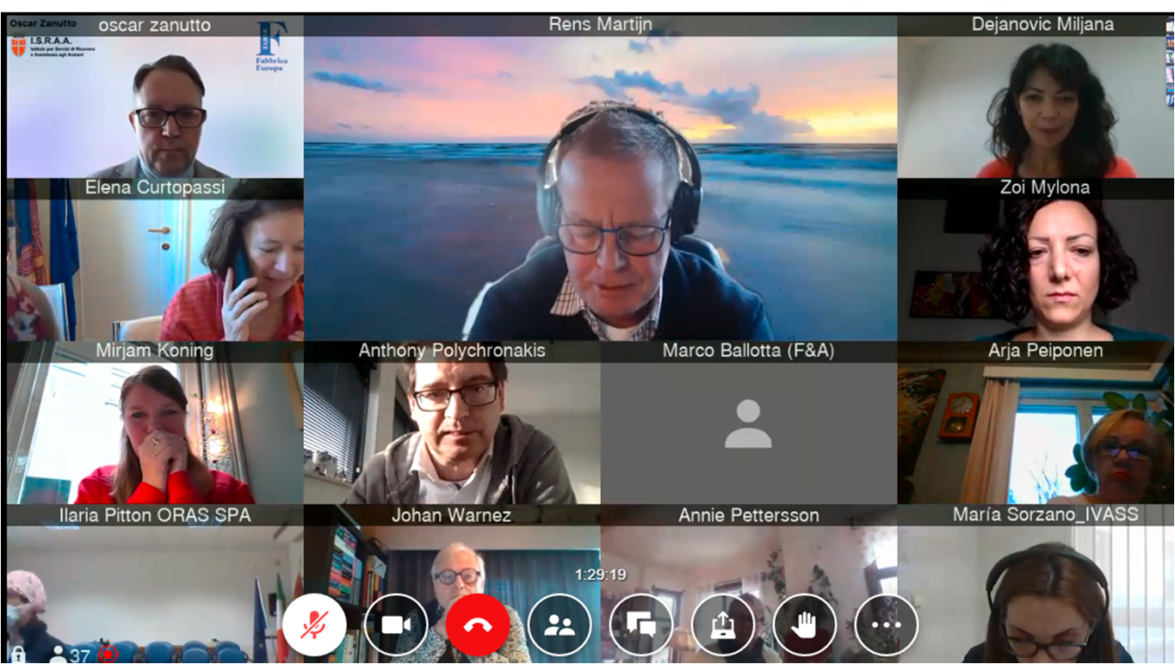
ENSA NETWORK

Slide 19

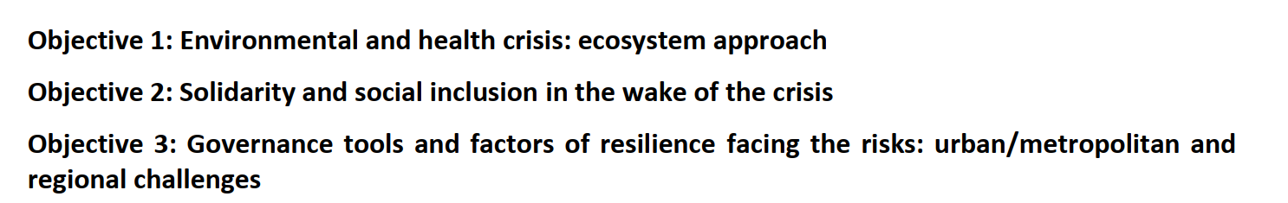
COUNSIL OF EUROPE
Committee on Environmental and Sanitary Crisis
Council of Europe - Committee on Environmental and Health Crisis

Slide 20
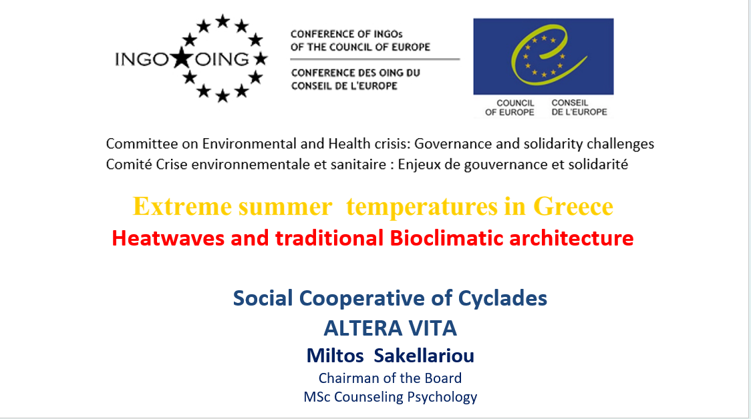

Slide 21
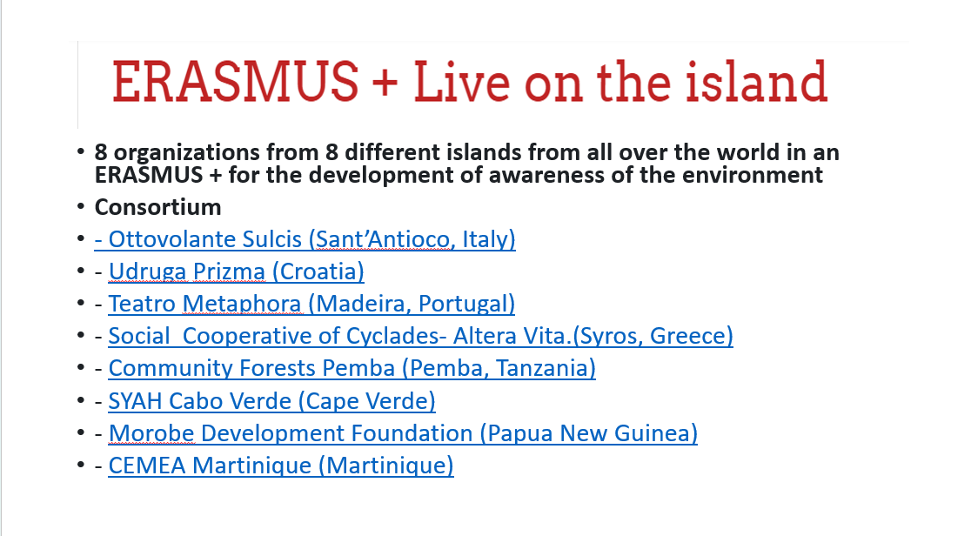

Slide 22
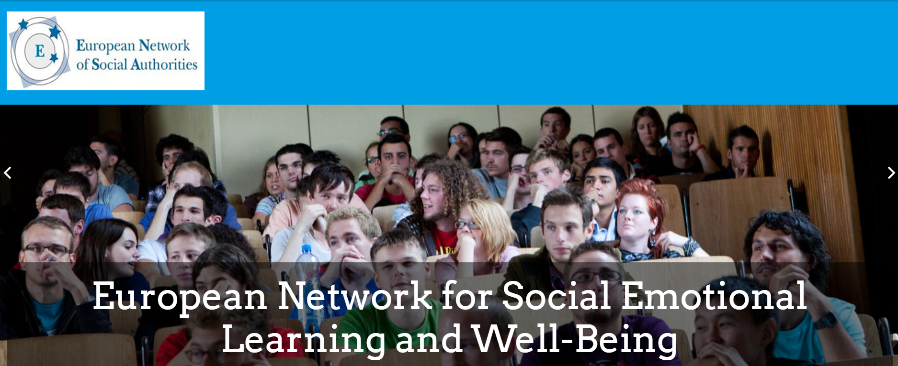

https://en-sel.eu/

Slide 23
ΕUROPEAN NETWORK FOR SEL
ALTERA VITA with Universities, Schools, and Organizations working on ERASMUS + projects, for the last years and continuing, have created educational tools for Social Emotional Learning, and they have established an informal network for Social Emotional Learning, ENSEL NETWORK.

Slide 24

At the Annual Assembly of ENSA on 15th November 2022 in Venice, after a proposal of Annalisa Bisson, Legal Representative of ENSA network - Director of International Relations, Veneto Region, and the acceptance of the Members, was created a new working group for promoting well-being and implementing Social Emotional Learning in Europe.
The present coordination of the thematic ENSA working group- Wellbeing and Social Emotional Learning for the next 4 year is led by the
Social Cooperative of Cyclades - ALTERA Vita.

Slide 25
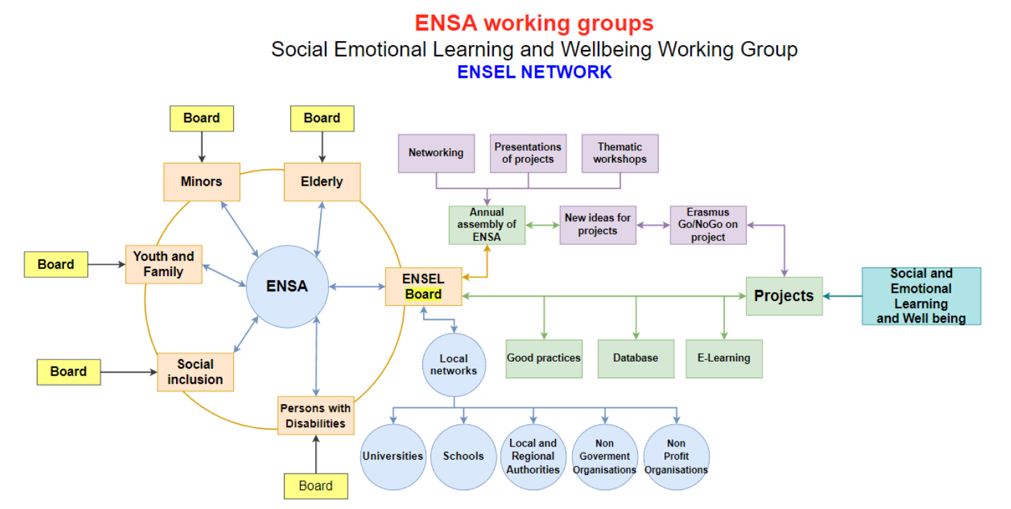

Slide 26
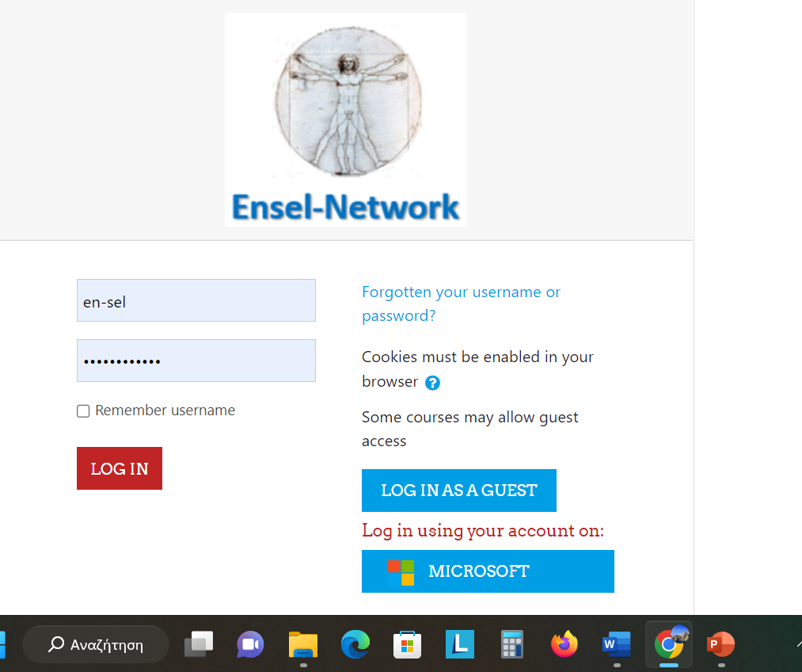

Slide 27



Slide 28
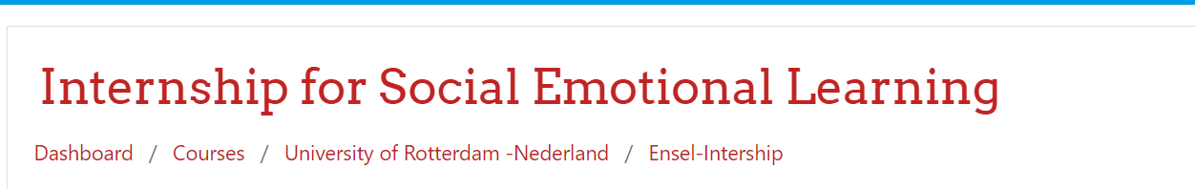
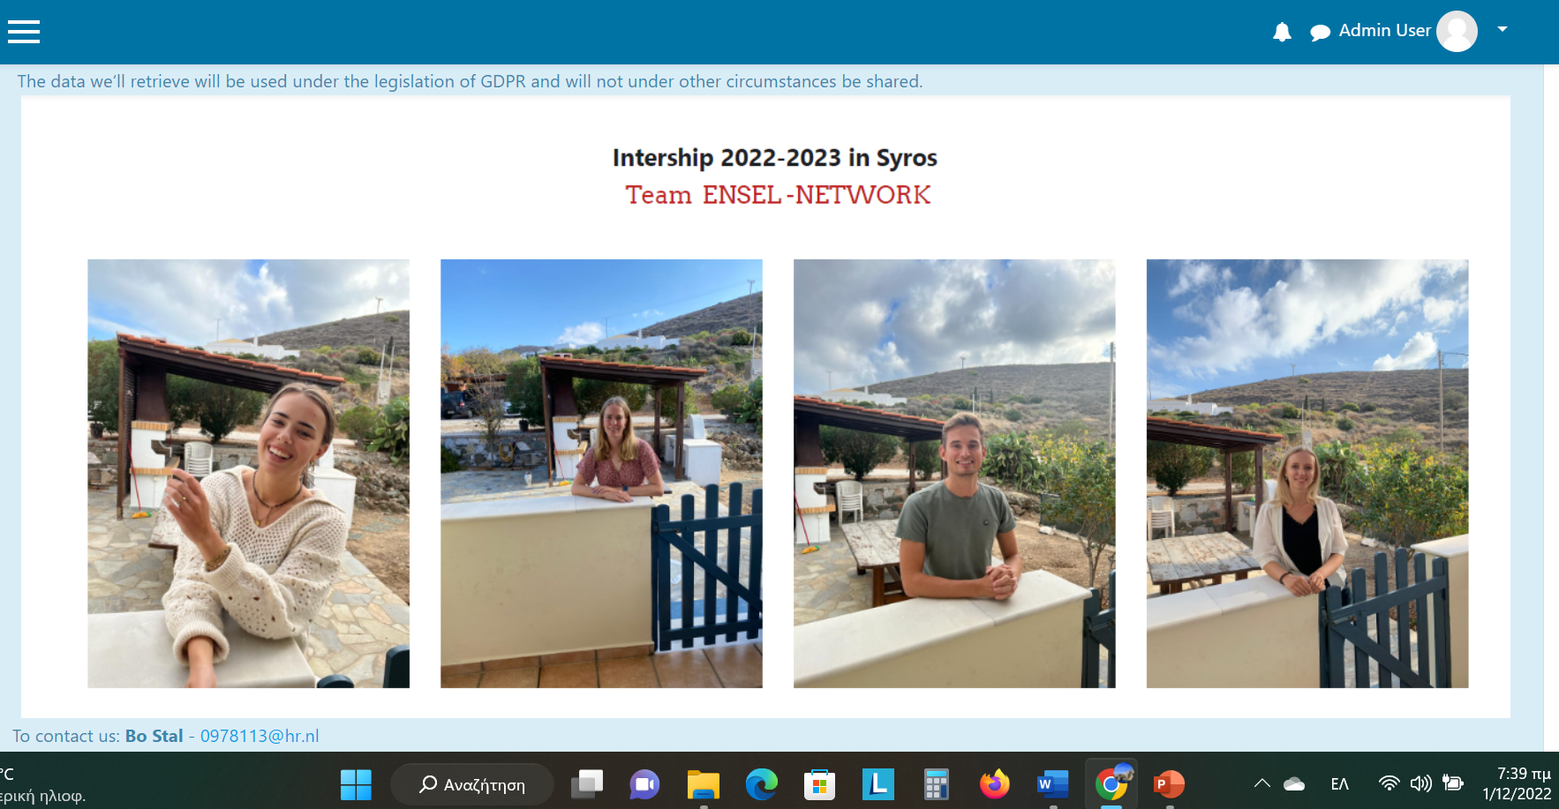

Slide 29

ERASMUS + KA1 Higher Education
Hosting Organization of students of University of Rotterdam and University of UTRECHT, for a traineeship in TELEMEDICINE.
The traineeship is aimed at investigating and finding ways to improve the telemedicine system in Greece.
E- course Telemedicine in Greece.

Slide 30
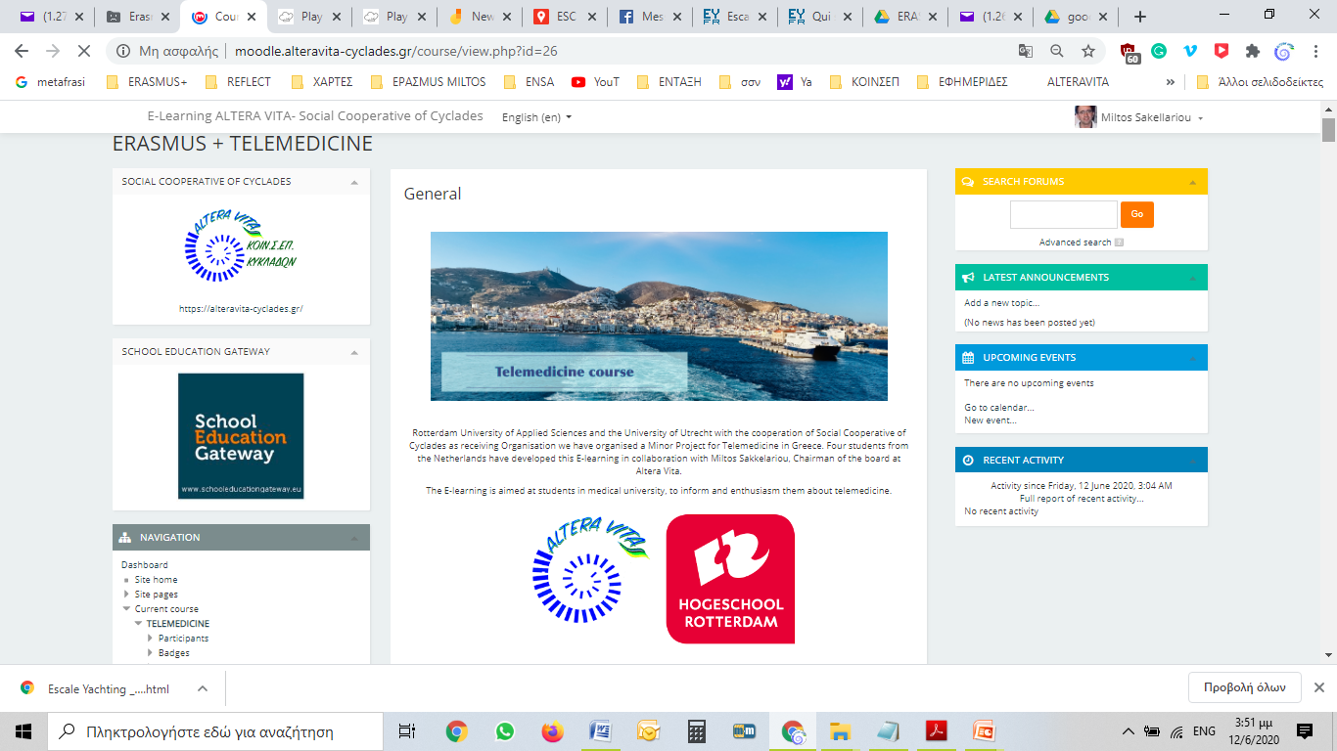

Slide 31

MOODLE PLATFORM

Slide 32


E-Learning- Social Cooperative Cyclades
methods and techniques and asynchronous distance learning
electronic manufacturing course with popular e-learning environment / teaching
Create e-courses through the platform MOODLE

Slide 33

ALTERA VITA

Slide 34
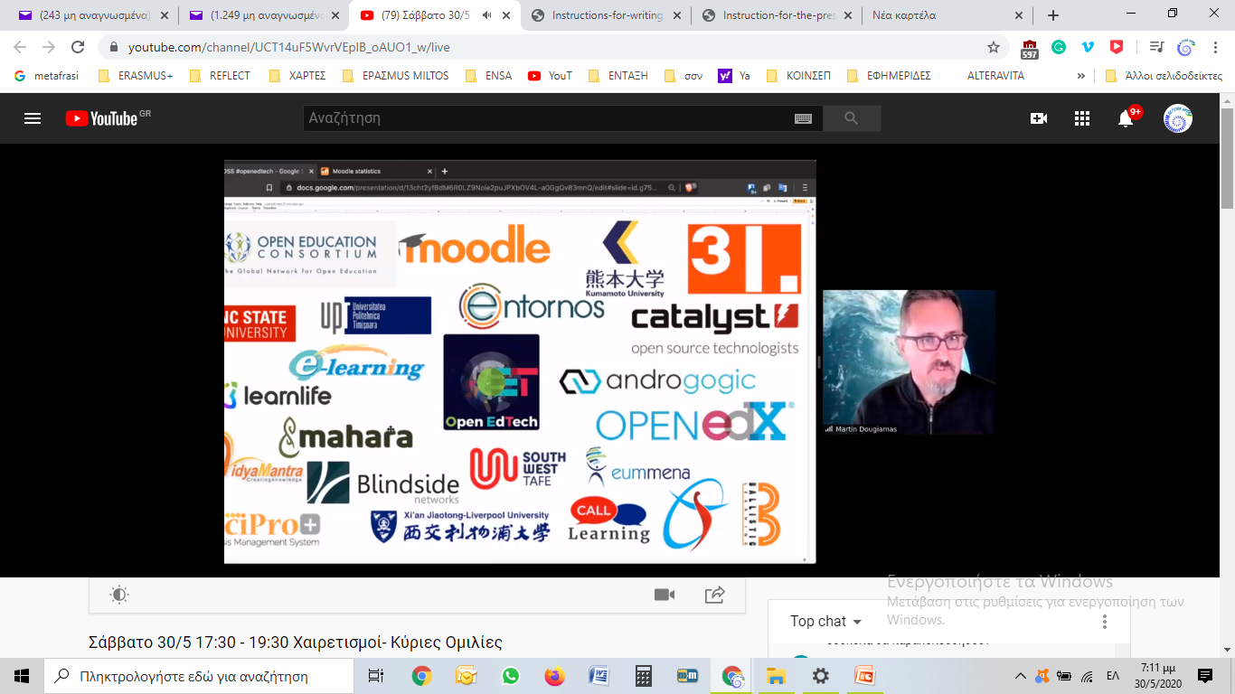
Open-Source Community

Slide 35
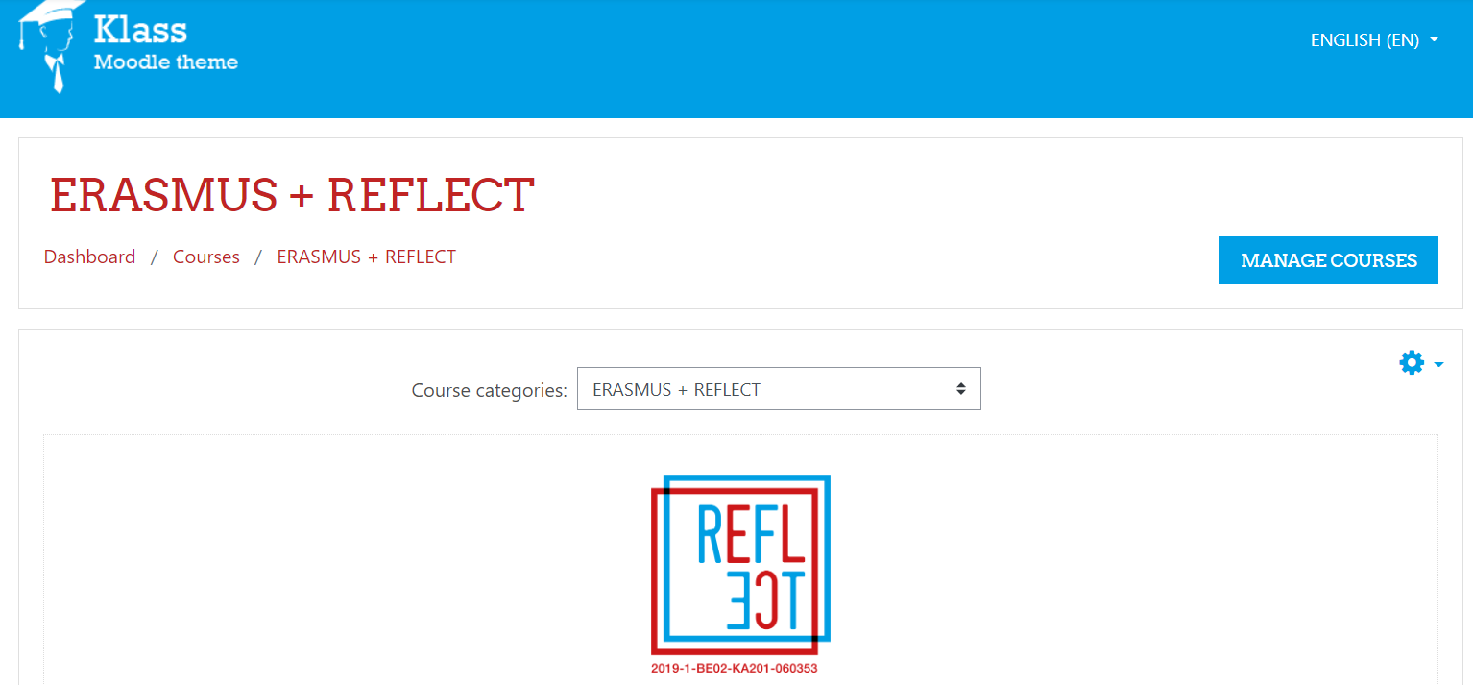

MOOC for caregivers: development and design

Slide 36


Slide 37
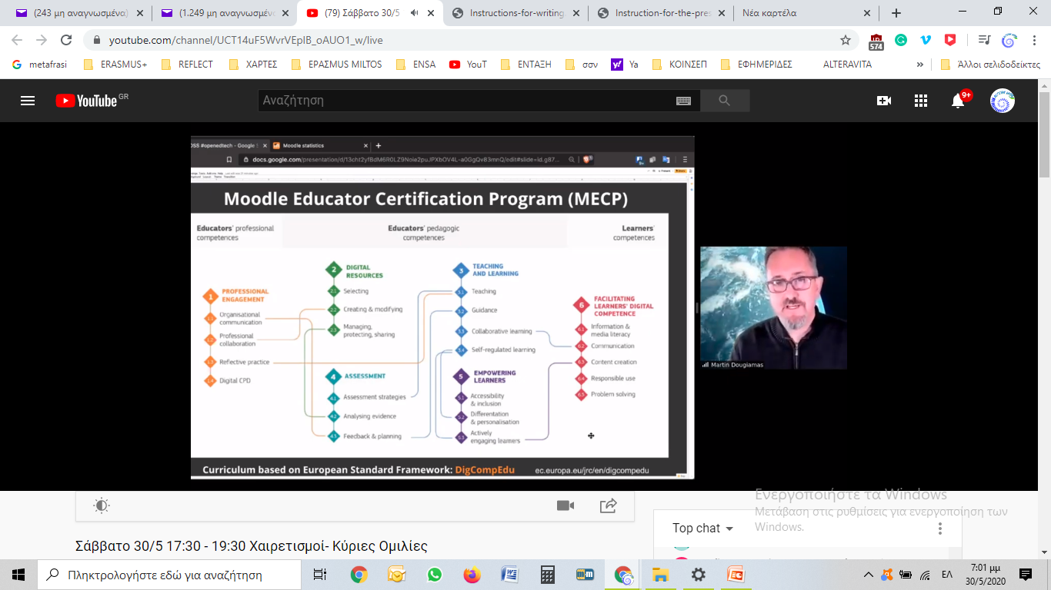
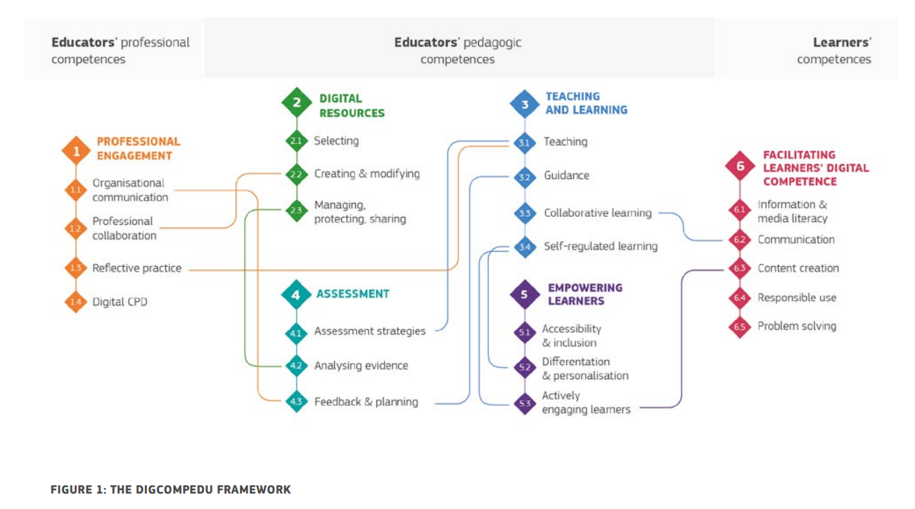

Slide 38
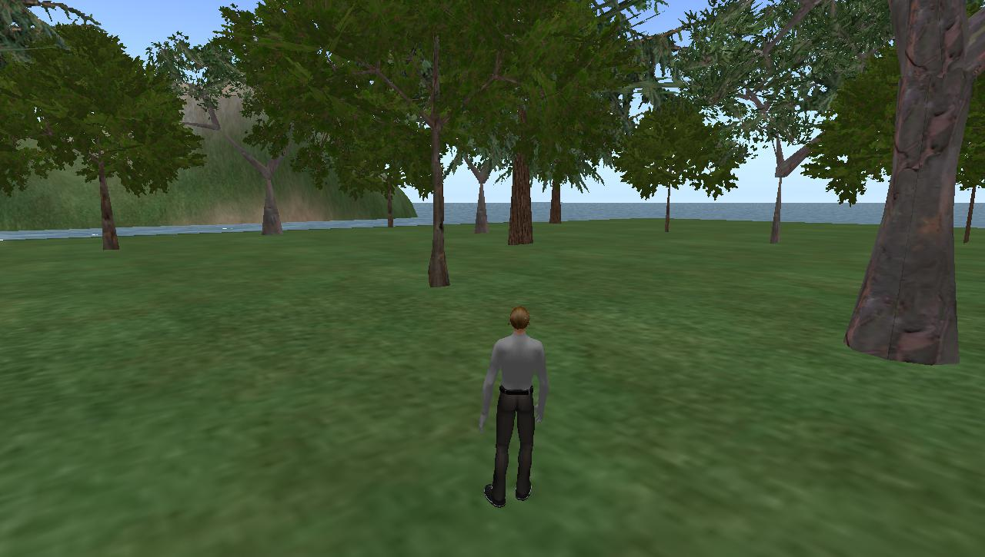
INTERACTIVE SEMINARS BY WEB

Slide 39
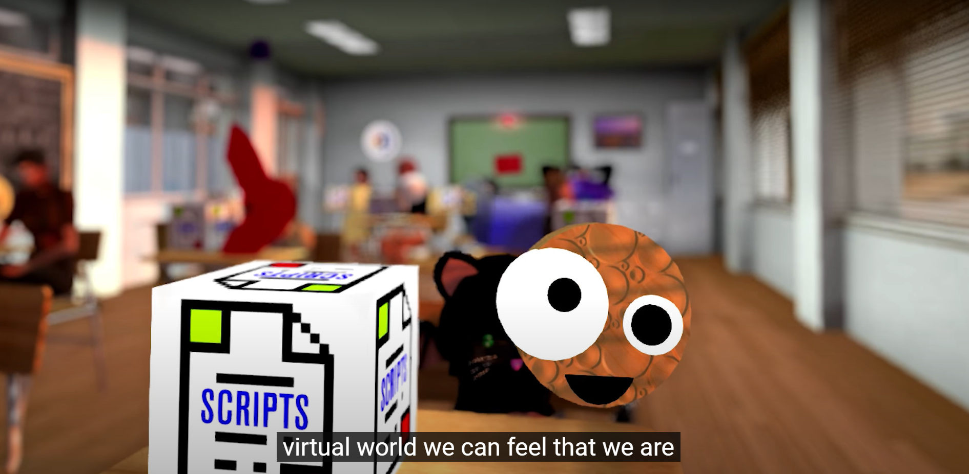

Slide 40
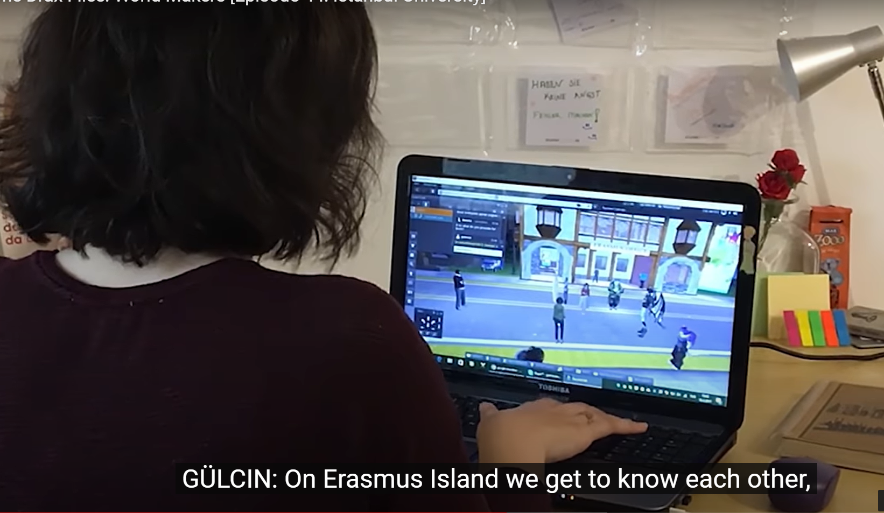

Slide 41
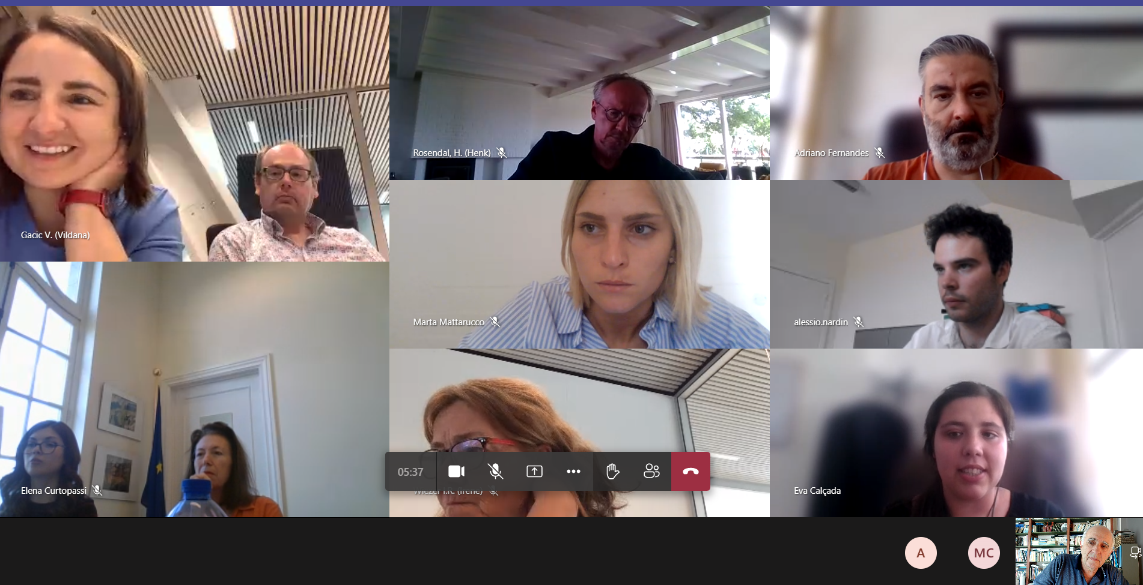

Slide 42
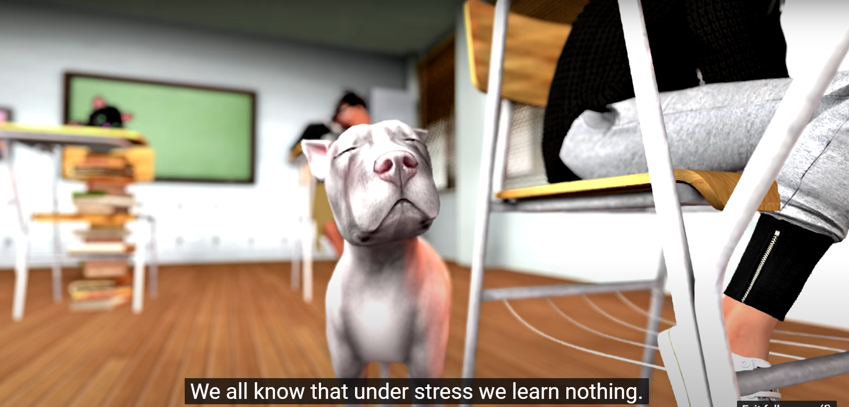

Slide 43
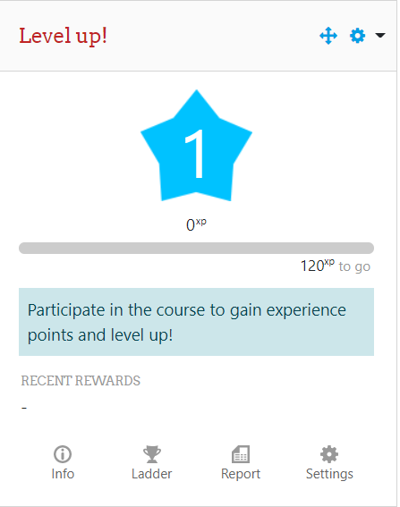
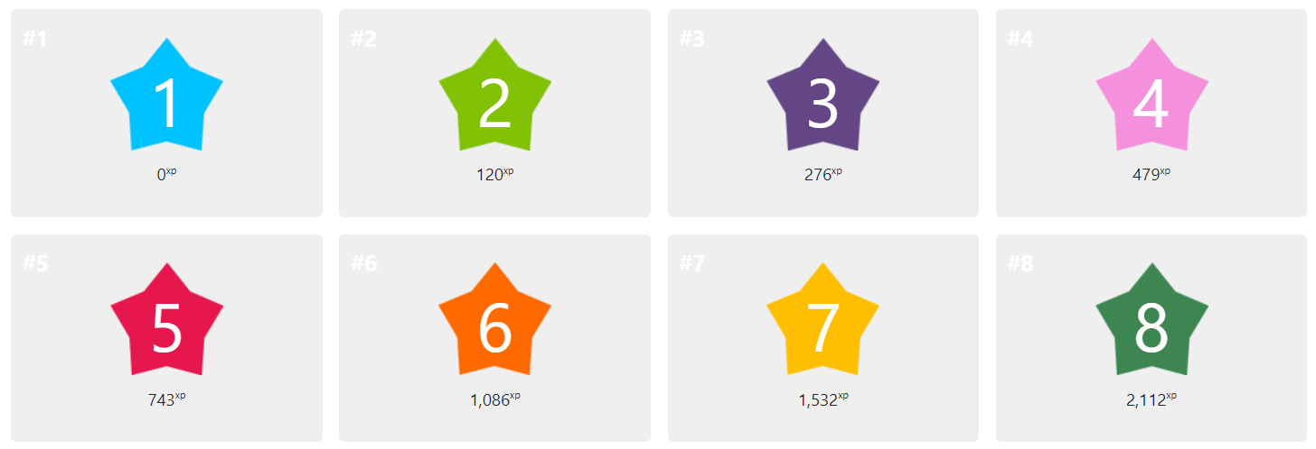
LEVEL UP-GAMIFICATION

Slide 44
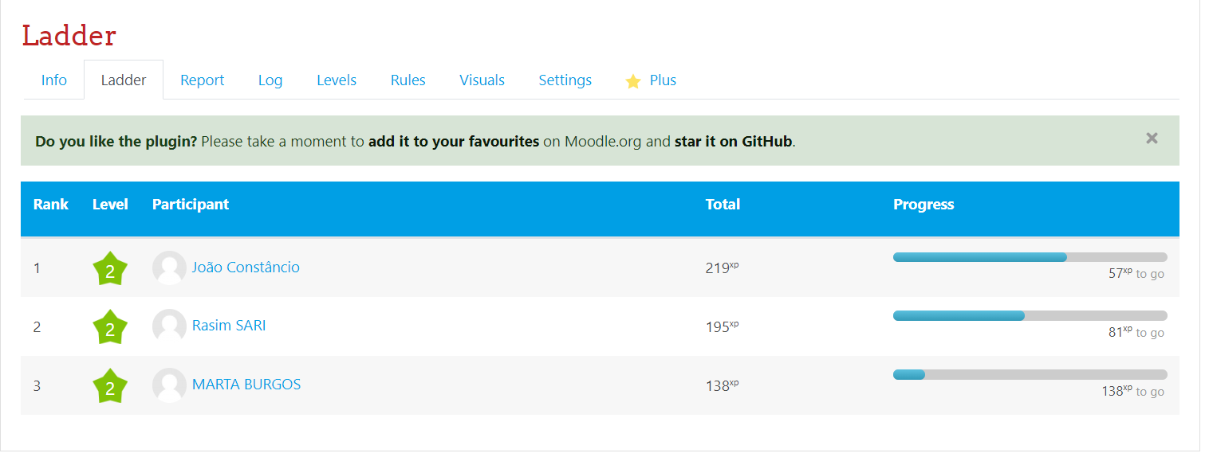
GAMIFICATION

Slide 45
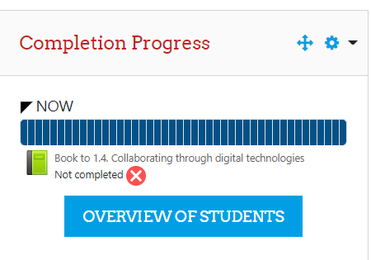
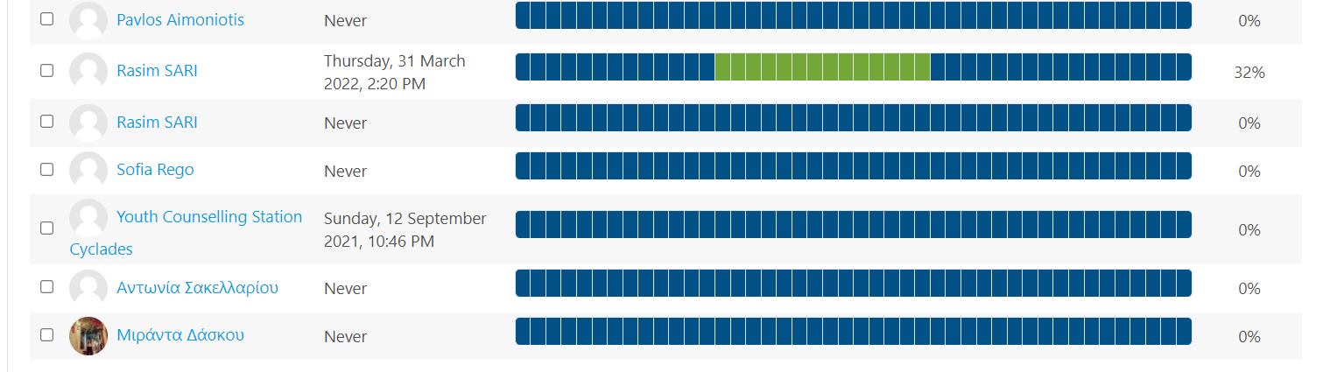

Slide 46
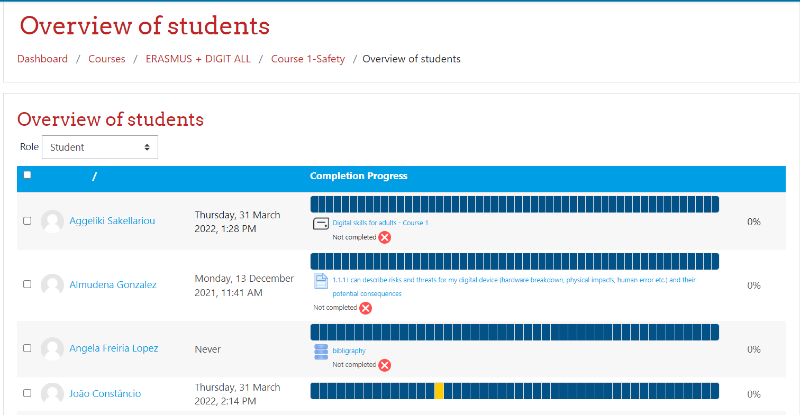
GAMIFICATION

Slide 47
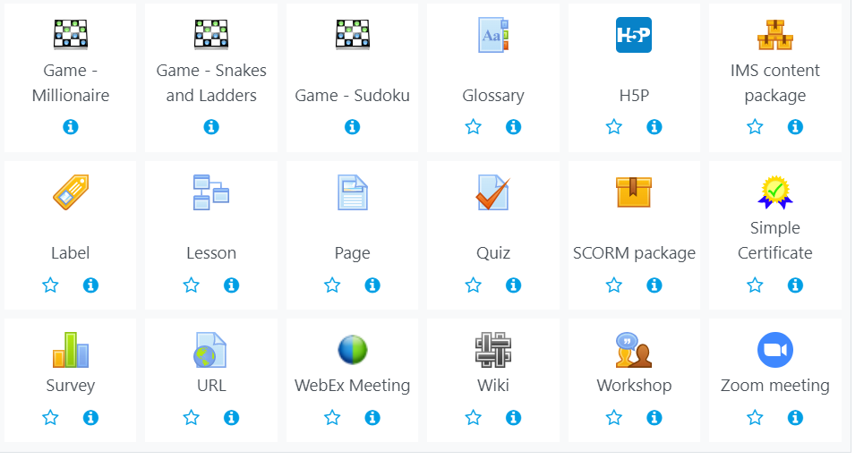

Slide 48
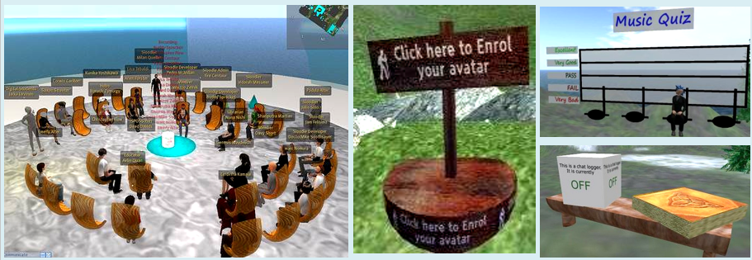
SLOODLE – E LEARNING FOR VIRTUAL WORLDS

Slide 49
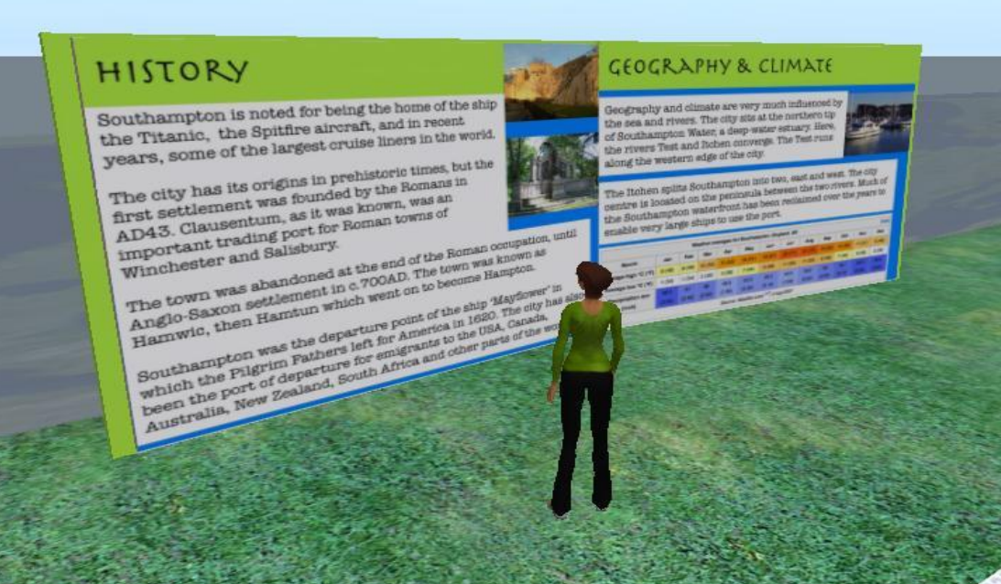

Slide 50


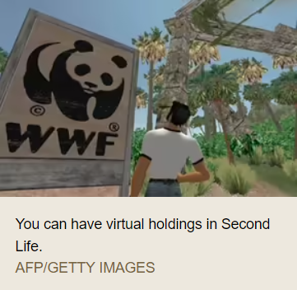

Slide 51



Slide 52
JEUNE THEATRE EUROPEEN
ALTERA VITA is also active Member of the European Network of Youth Theatre.
Member of the International Artistic Committee of the EUROPEAN FESTIVAL OF YOUTH THEATRE based in GRENOBLE- France, since 1989.
http://www.crearc.fr/pages-new/?ref_partie=jte&trad=fr

Slide 53
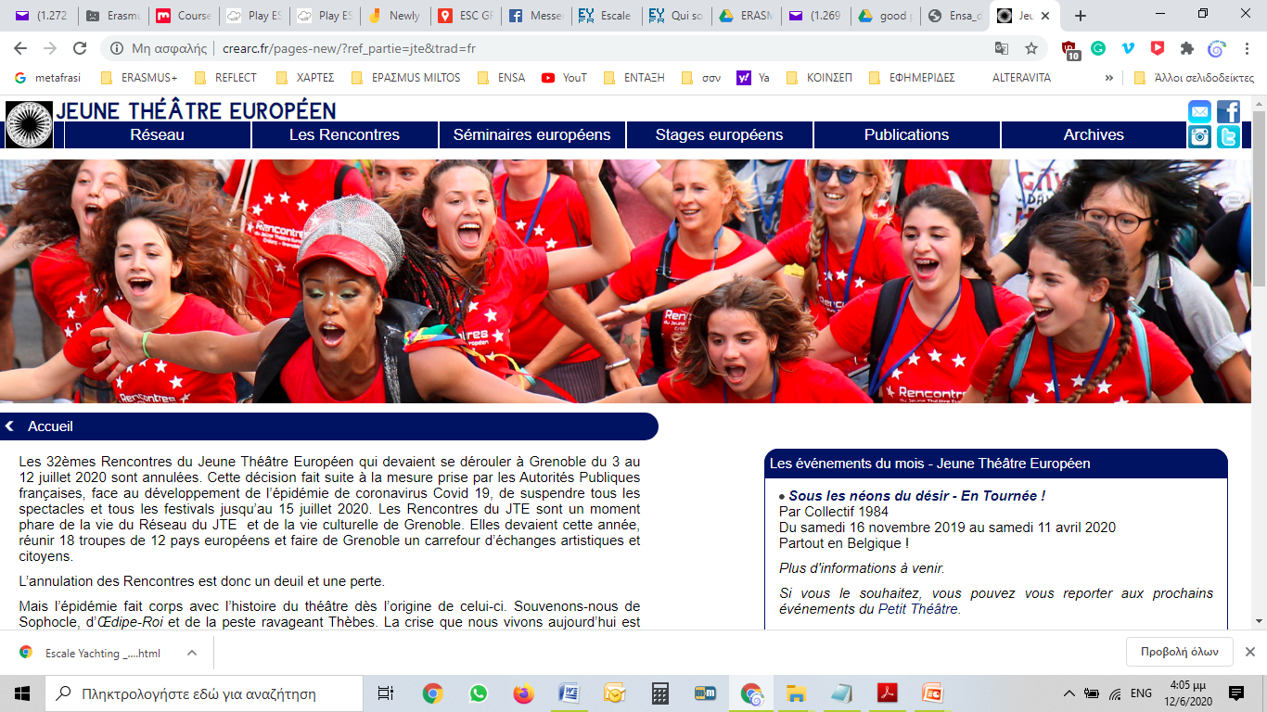
JEUNE THEATRE EUROPEEN

Slide 54
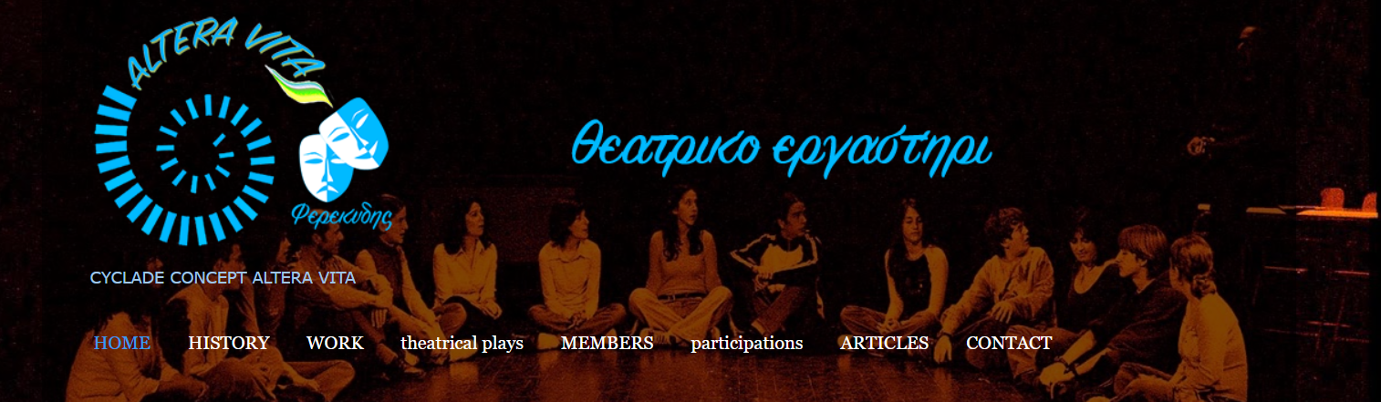
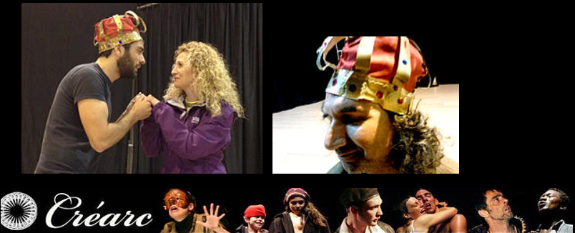


Slide 55
ALTERA VITA-Prevention Programmes
Holistic -systemic approach
Involving youngsters in arts, sports and outdoor activities
Volunteers- parents-educators-youth workers
Mentors
Developing and establishing permanent connections between students, teachers, public institutions and the private sector.
Creating and supporting networks of prevention programmes for bulling, drugs, sexual education, human rights.

Slide 56
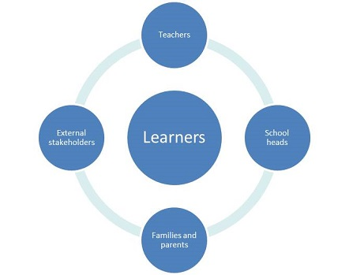
HOLISTIC APROACH

Slide 57
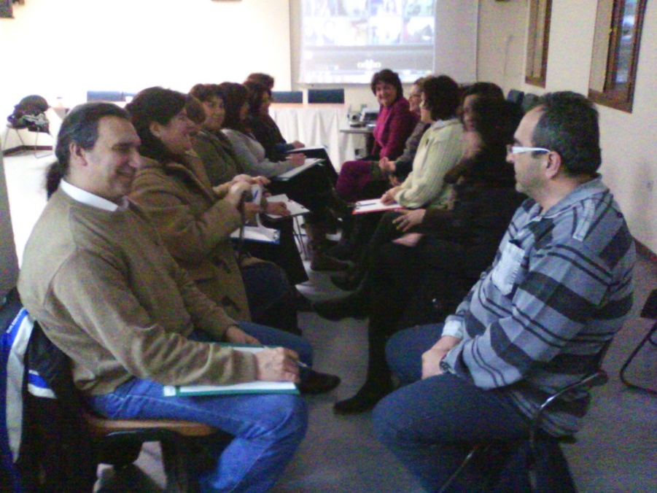
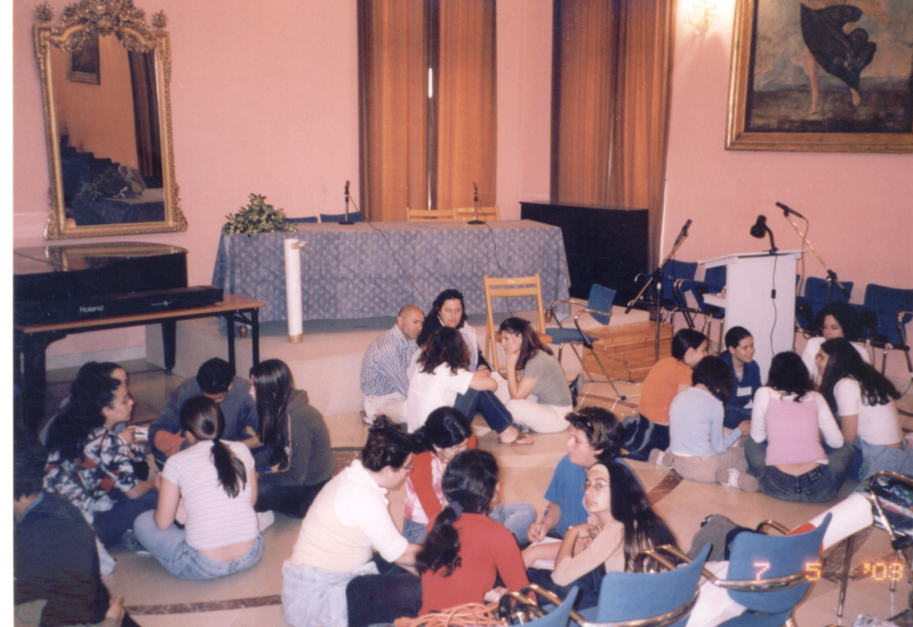
Social Cooperative Of Cyclades
The objectives of the Cooperative are to:
Assist the psychosocial needs of school units of the Cyclades prefecture, through the identification, diagnosis, brief psychological intervention and referral of cases of students who deserve psychological treatment.
Parents- Teachers counseling groups.
Implement, support and monitor Health Promotion programmes for students.

Slide 58

Prevention Programmes in Schools

Slide 59
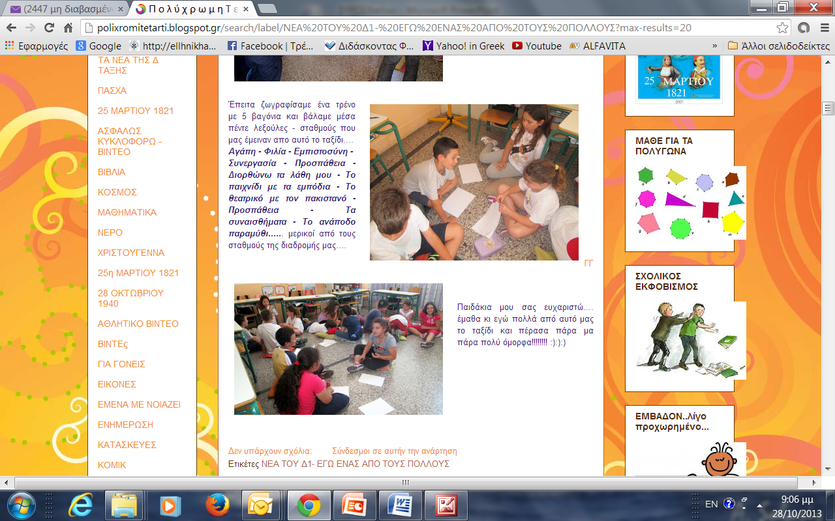

Slide 60
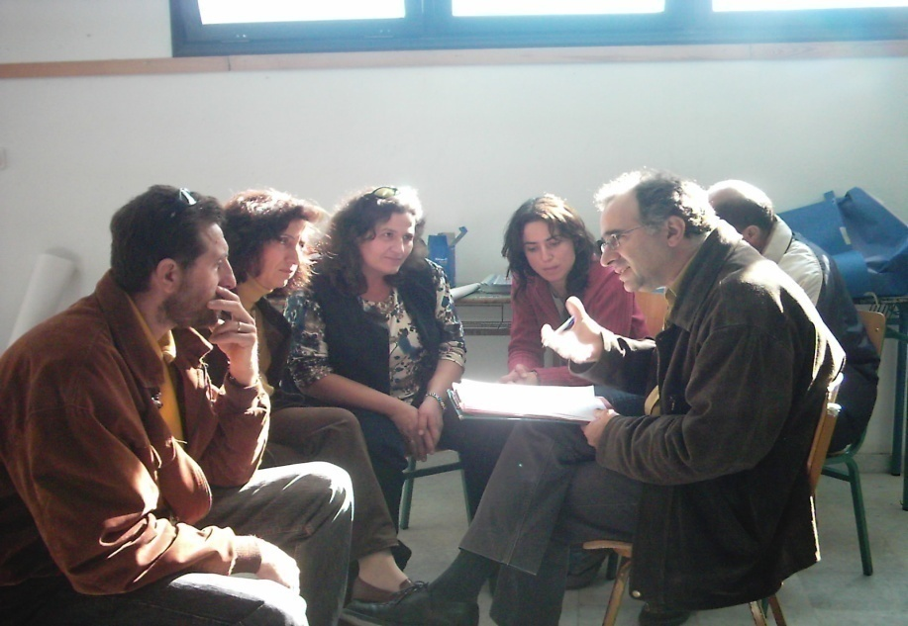



ENVIROMENT-Walk along the paths of my island – discover myself

Slide 61




FESTIVAL OF THE PATHS
Parents- Educators - Adolescents

Slide 62


FESTIVAL OF THE PATHS
Parents- Educators - Adolescents.
4 days festival at Syros with the cooperation of the PREVENTION NETWORK AND HEALTH PROMOTION of the Cyclades

Slide 63


Slide 64



Slide 65


Social Cooperative of Cyclades
Health Promotion programmes
for students of the
Elementary and
High Schools
Psycho-educational intervention programmes to manage school violence, Bullying, drugs,
Early School Leaving, SEL

Slide 66

Travelling in the Aegean Sea and its life
Social Cooperative of Cyclades
Summer teen groups,
By working with drama therapy on sailing courses.
to increase self-awareness and social skills useful for the "journey" of life, through experiential exercises.

Slide 67


Mixed Theatrical team
Social Cooperative of Cyclades
Parents
Teachers
Teens
Create plays with process work and Drama therapy

Slide 68






Theatrical team

Slide 69





Mixed Theatrical team-Ferekidis
The slap
www.ithakes.gr
& έφηβοι.
Παραστάσεις στο θέατρο ΑΠΟΛΛΩΝ της Σύρου.

Slide 70

EUROPEAN NETWORK OF YOUTH THEATRE
GRENOBLE, France

Slide 71

EUROPEAN FESTIVAL OF YOUTH THEATRE
GRENOBLE, France 2005.

Slide 72

EUROPEAN FESTIVAL OF YOUTH THEATRE
GRENOBLE- France-2008

Slide 73

EUROPEAN FESTIVAL OF YOUTH THEATRE
GRENOBLE- France 2012

Slide 74


Theatrical Team FEREKYDIS
Social Cooperative of Cyclades

Slide 75
Social Cooperative of Cyclades
EUROPEAN Projects
ERASMUS+KA2–YLYS:2017-1-PL01-KA204-038666, applicant CKU BIALYSTOK, from POLAND, for the YLYS project
ERASMUS KA2 – WHY: 2017-1-SE01-KA201-034597, applicant Municipality of VASTERAS from Sweden, for the WHY project.
ERASMUS + KA2 :2019 KA201-CBFBCC04- REFLECT applicant TOPUNT GENT- Belgium.
ERASMUS +KA2: 2020-KA204-2220CB02- DIGIT-ALL, Digital skills for adults, applicant Orbis Institute, Slovakia.
ERASMUS +KA2: 2020- KA204-A29E0F47- The Living Art - The Art of Living applicant CKU BIALYSTOK, from POLAND
ERASMUS + KA2: 2020 619480-EPP-1-2020-1-IT-EPPKA2-CBY-ACPALA, Live on the island, applicant Associazione Ottovolante Sulcis , Italy
ERASMUS +KA1: 2019-1-TR01-KA105-073564 applicant Rhythm for Peace, Turkey
ERASMUS + KA1 : 2019-2020 Higher Education –NLROTTERD03 2019/20 as receiving Organization of students of University of Rotterdam for a traineeship in TELEMEDICINE.
ERASMUS + KA1 : 2019-2020 Higher Education – NLUTRECHT24 2019/20 as receiving Organization of students of University of UTRECHT for a traineeship in TELEMEDICINE.
ERASMUS +KA 1 : No 1-FR01-KA102-047463 with the Ecole Regionale de la deuxieme chance de Toulouse.
European Solidarity Corps 2020-1-EL02-ESC522018-
-005925, Quality Label as hosting and Sending Organization for European Solidarity Corps
Participation at the European Seminar « Echanges Culturels de Jeunes par le Théâtre, Quels enjeux et quel avenir dans un monde en crise ? » May 2016 CREARC-Grenoble.

Slide 76



Erasmus+

Slide 77

STORYTELLING- GREECE

Slide 78

STORYTELLING- GREECE

Slide 79

STORYTELLING- TRAINING GREECE

Slide 80

European Solidarity Corps

Slide 81
Multifunction Farm ALTERA VITA
ALTERA VITA has agricultural production of aromatic and medicinal plants of our country,
ALTERA VITA, act as a catalyst in our community, aiming at the Well Being and the sustainable development.
We owned agricultural land and we plant aromatic plants such as sage, thyme, safflower, rosemary, oregano, of local products of Syros.

Slide 82


Slide 83
Altera Vita-Virtual Study Visit
It is a great Honour for us and we will try to share with you our experience, to start a dialogue and of course to be part of the European network, Europe Goes Local
We want to thanks our Hellenic National Agency for Erasmus+ and European Solidarity Corps Resource Centre and Youth and Lifelong Learning Foundation,
for the proposition to realise this virtual study visit and gave us the power to work for this visit inside of our holidays!
You can visit us virtually following the link!
virtual study visit

Slide 84

Europe goes Local

Slide 85


Live on the island

Slide 86


Slide 87

Web page - Live on the island
https://liveontheisland.eu

Slide 88


Slide 89



Slide 90


Slide 91


Slide 92

European Solidarity Corps

Slide 93

THANK YOU!!

